Slide 1

Olist Brazilian E-commerce Data Analysis
Exploratory Data Analysis

Slide 2
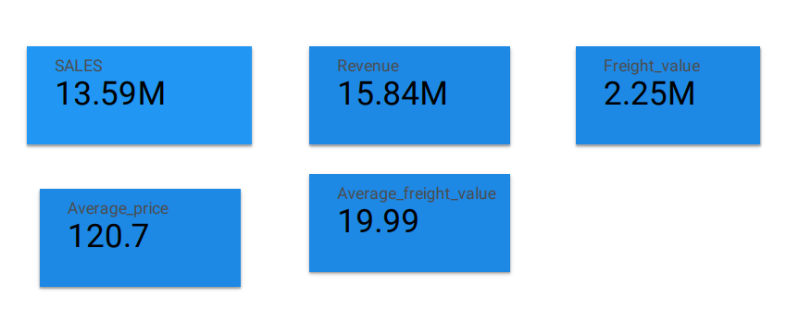
General Overview of the Performance
The analysis is for two years from 2016 to 2018.
There are around 99 000 items orders during the two fiscal years.
97 % of the orders have been delivered.

Slide 3
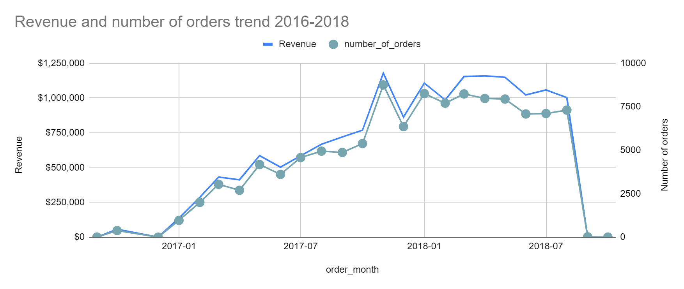
E-commerce on Brazil really has a growing trend along the two years. The revenue and orders started to rise from March 2017 and continued to stabilize after. We can also see seasonality peaks at specific months, for example November 2017 with the highest order received. n that same note, there was a huge sharp decrease ee August 2018 to October 2018. The E-commerce on Brazil really has a growing trend along the two years. The revenue and orders started to rise from March 2017 and continued to stabilize after. We can also see seasonality peaks at specific months, for example November 2017 with the highest order received. On that same note, there was a huge sharp decrease between August 2018 to October 2018. Brazil really has a growing trend along the two years. The revenue and orders started to rise from March 2017 and continued to stabilize after. We can also see seasonality peaks at specific months, for example November 2nnn with the highest order received. On that same note, there was a huge sharp decrease between August 2018 to October 2018.

Slide 4
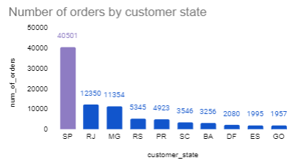
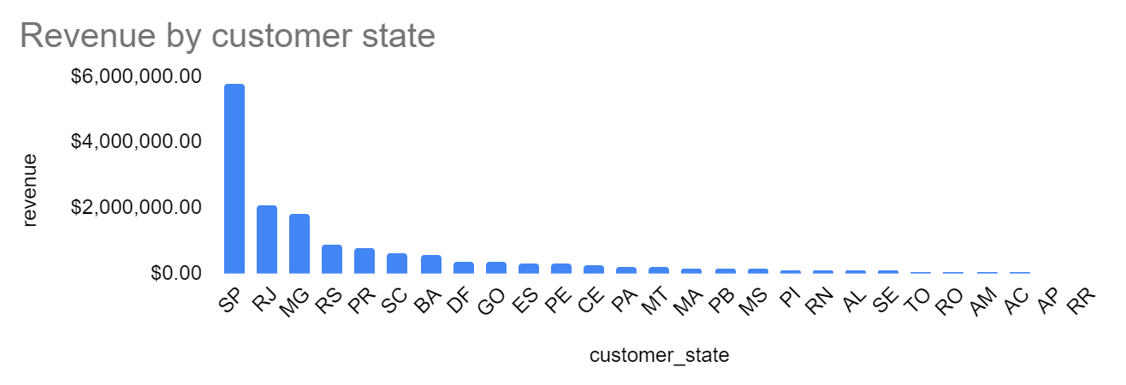
Distribution of customers
Most of the customers are coming from the top 10 cities Sao Paulo and Rio de Janeiro being the largest capitals in Brazil.
High volumes of orders are coming from these Top 10 States below, highest being Sao Paulo.

Slide 5
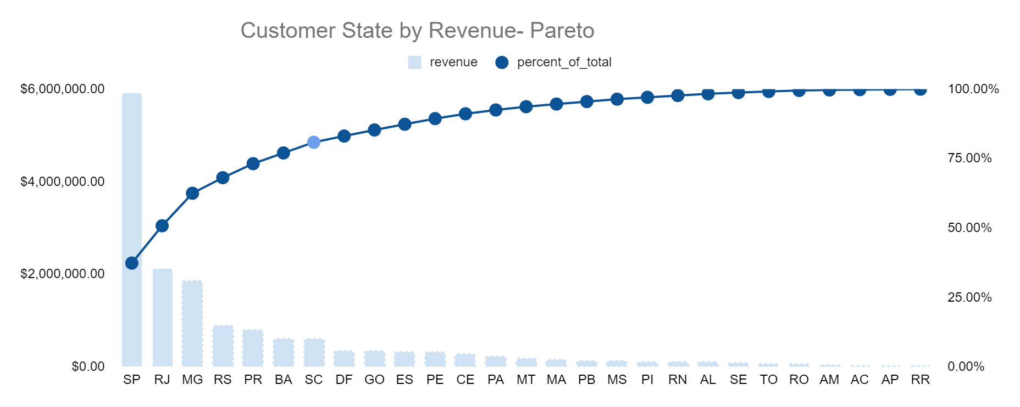
Customer State with the Pareto Principle Profitability will bear most fruits in the first 7 States of Brazil. These are locations with customers who are contributing positively to the revenue. The first 7 states comprise roughly 80% of the total revenue. From this insights, these are areas where the sellers can spend more efforts on as well to maximise profitability and volume improvements.

Slide 6
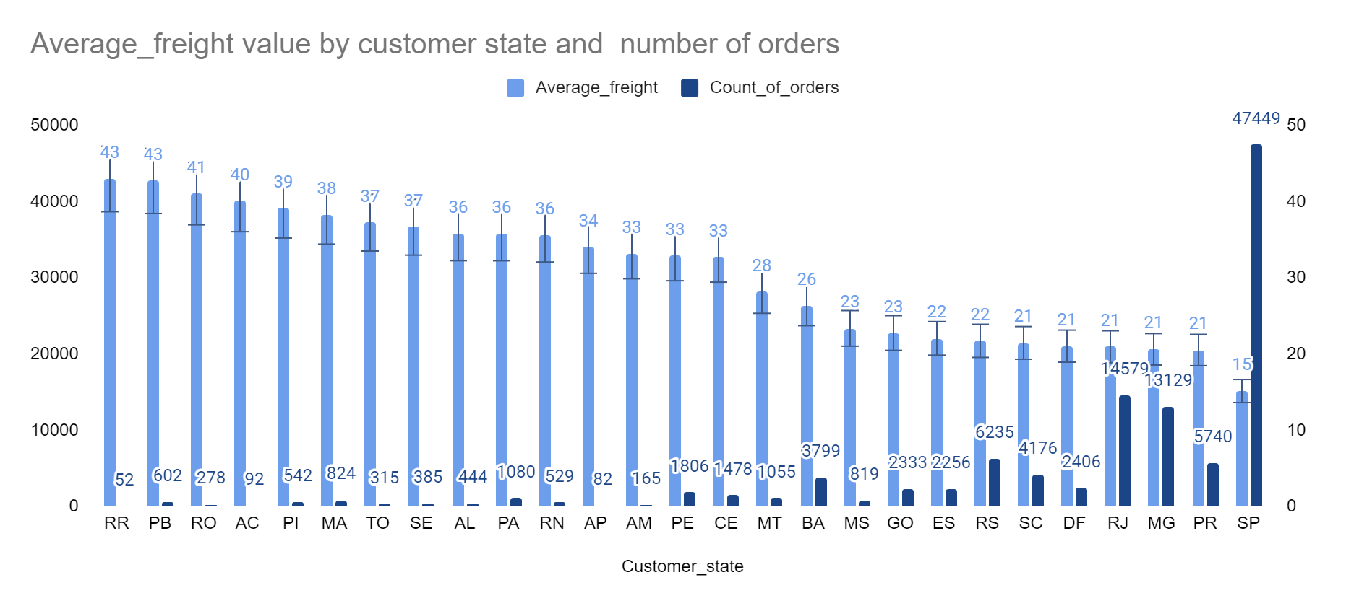
Freight value across the customer sates We can see that customers in States such as Roraina(RR), PB, RO,AC normally pays more than others, with average freight value ranging from 40 to 44. We also note that, customers in those states they tend not to order that much which might be as a reason of higher freight values.

Slide 7
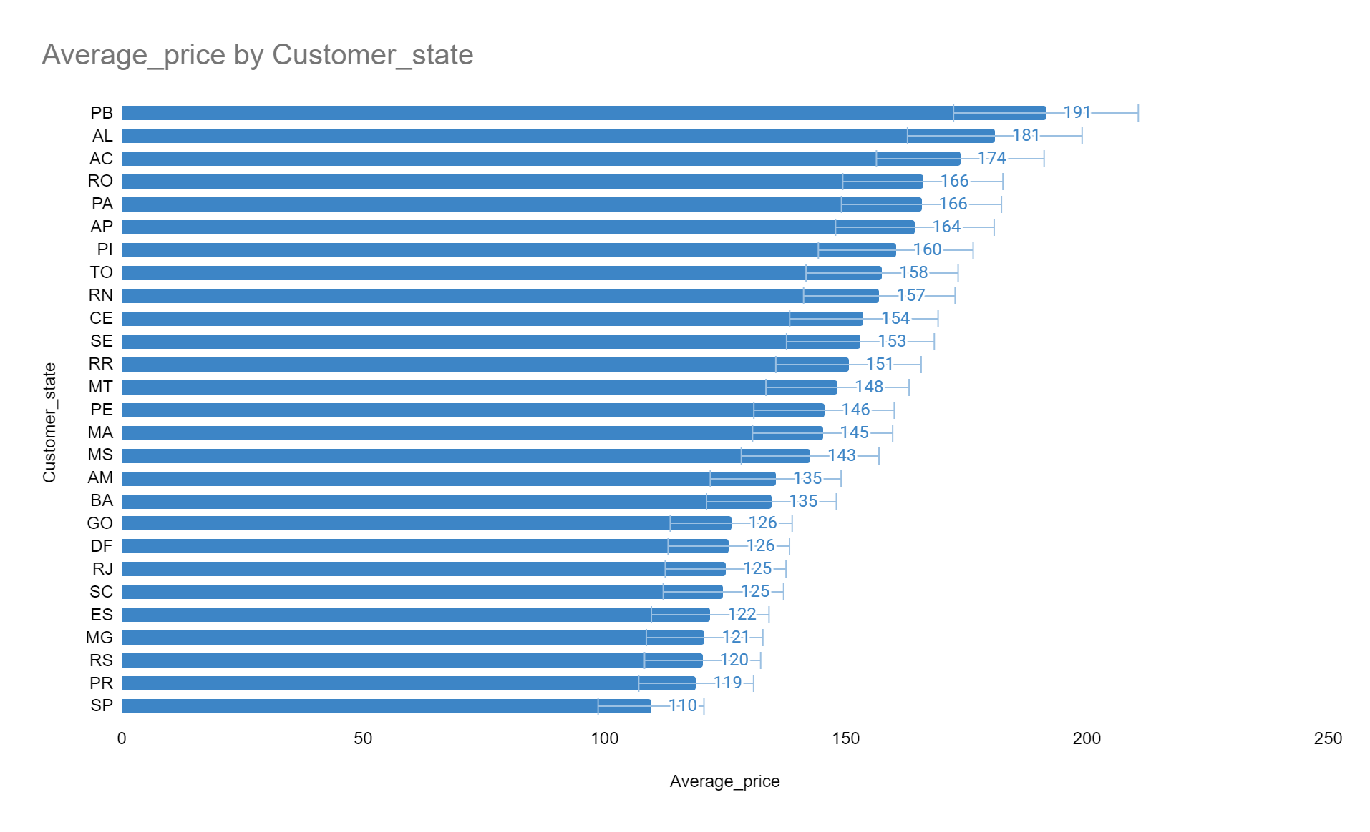
Customer state with Average price States with high total amount sold have a lower average price per order. For example, SP(Sao Paulo) it has the highest sales, but it is also where customers pay less per order around an average of $110 per order. Product with high orders are the ones with the average price per order. This helps to see customer preferences in terms of pricing products, selling and pricing efforts in relation to will these increase profitability and volumes.

Slide 8
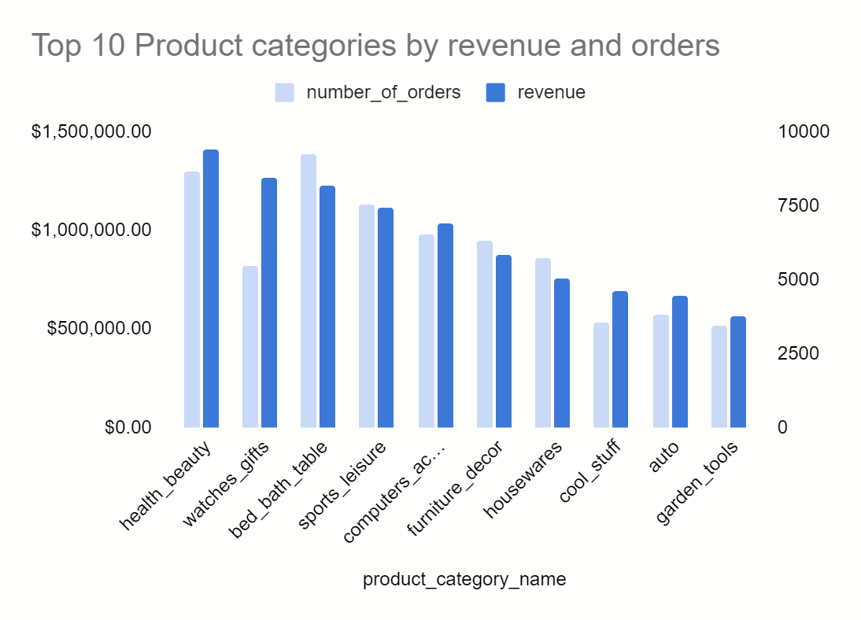
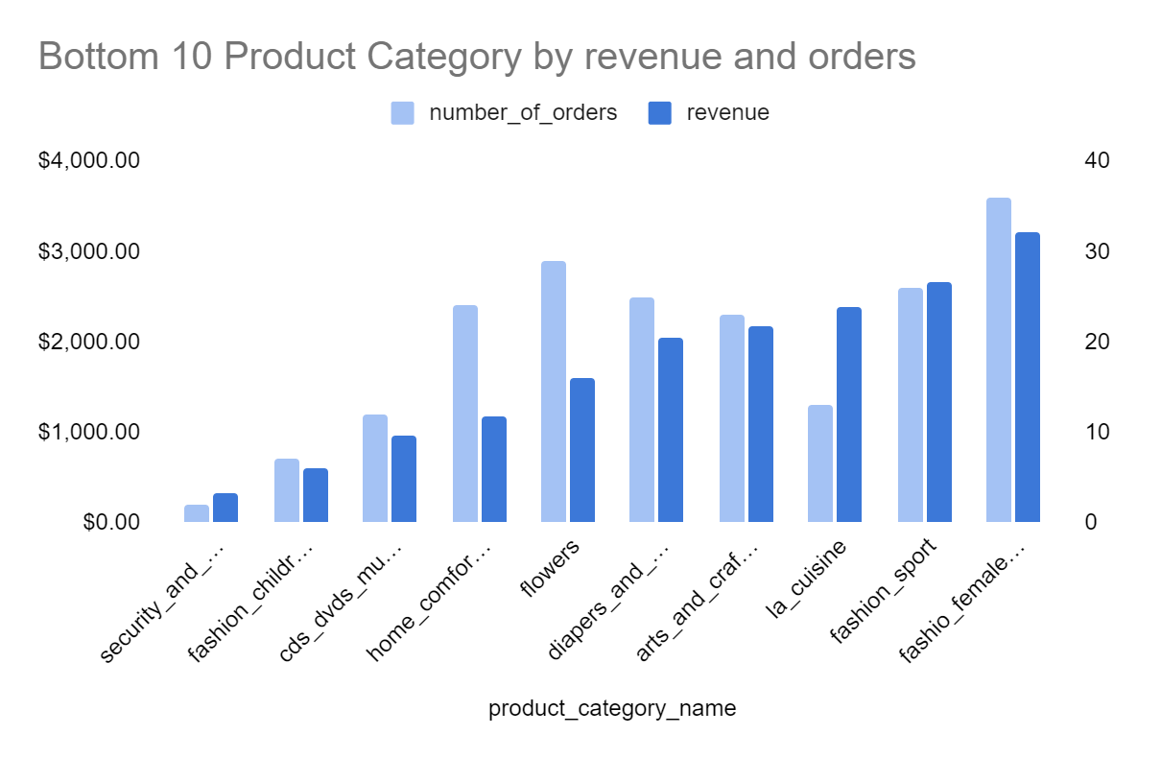
Product Category by revenue and orders.
Top 10 Product Category: Health beauty has the highest revenue from 2016 to 2018 and by orders it is Bed_bath tables. Also, in 2017 Health_beauty category is in third place, and in 2018 it has the most sales.
Bed_bath tables drops from ranking 1 to ranking 3 from 2017 to 2018. Also, interesting to note is watches_gifts have number of orders slightly close to housewares, but they are ranking number 2 in terms of revenue which shows that they also have an average high price.
Bottom 10: These helps us to show sellers where to focus their efforts more on and have further understanding why these products are not frequently ordered. Send out surveys. Identify elements of improvement and quality.

Slide 9
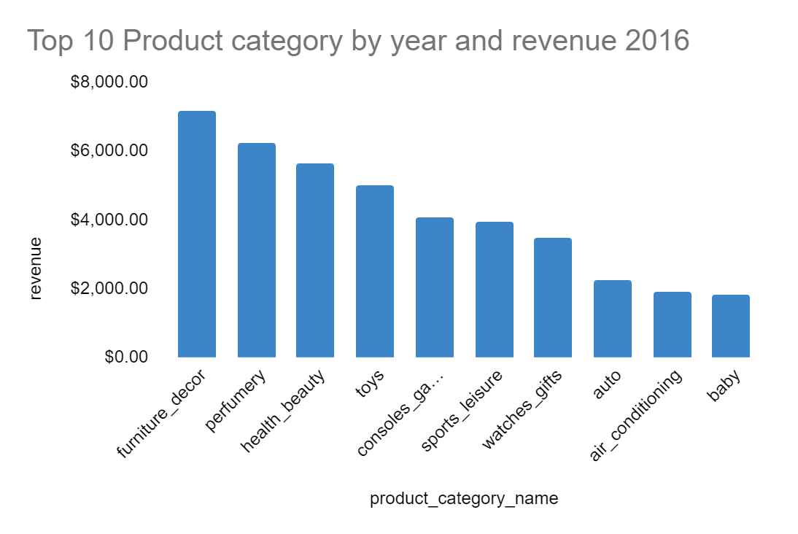
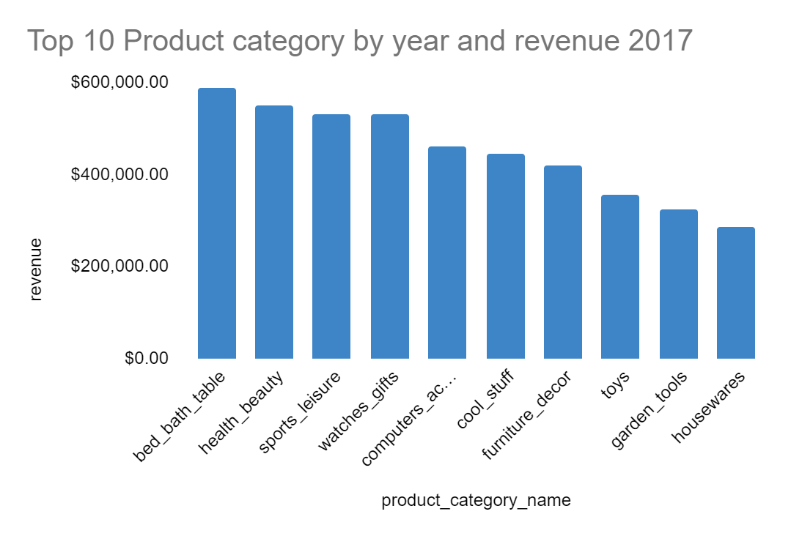
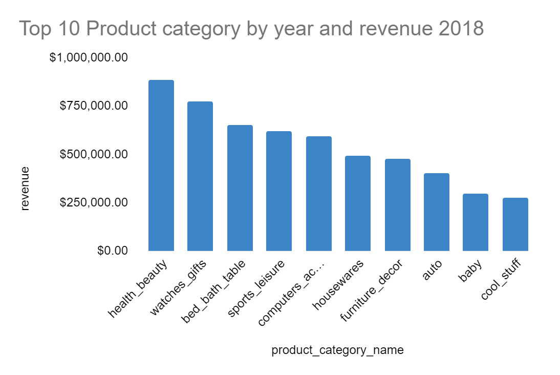
Top 10 Product Category by Year
In 2017 Health_beauty category is in third place, and in 2018 it has the most sales.
Bed_bath tables drops from ranking 1 to ranking 3 from 2017 to 2018. Managers can further review these products in order to drive profitability.

Slide 10
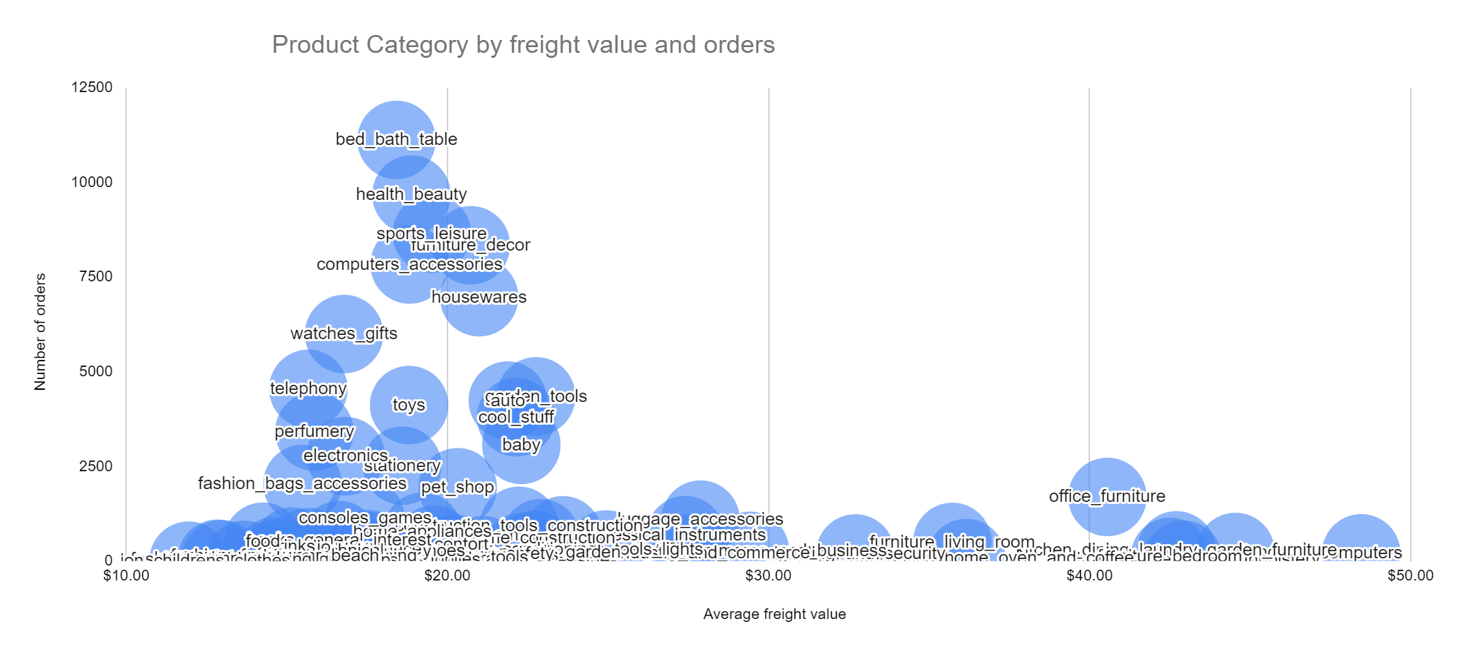
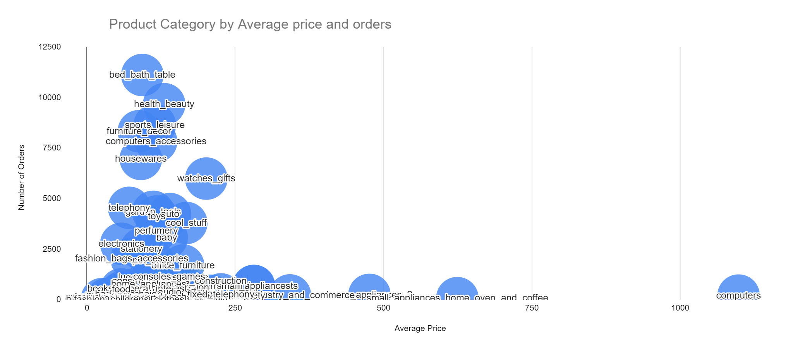
From the visuals below, products with higher freight values such as computers and furniture have lower orders than the ones which are ordered more such as bed_bath_tables with an average freight value of $19,99. Product with high orders are the ones with lower average price per order. This helps to see customer preferences in terms of pricing products, selling and pricing efforts in relation to will these increase profitability and volumes. The management can implement a slight price decrease to the customer in exchange for larger order quantities for products that have a high average value. A decrease in price may still yield to higher profits paired as well with decrease in freight values. This can be a win–win situation for the customer and the supplier.
Product Category by freight and Price

Slide 11
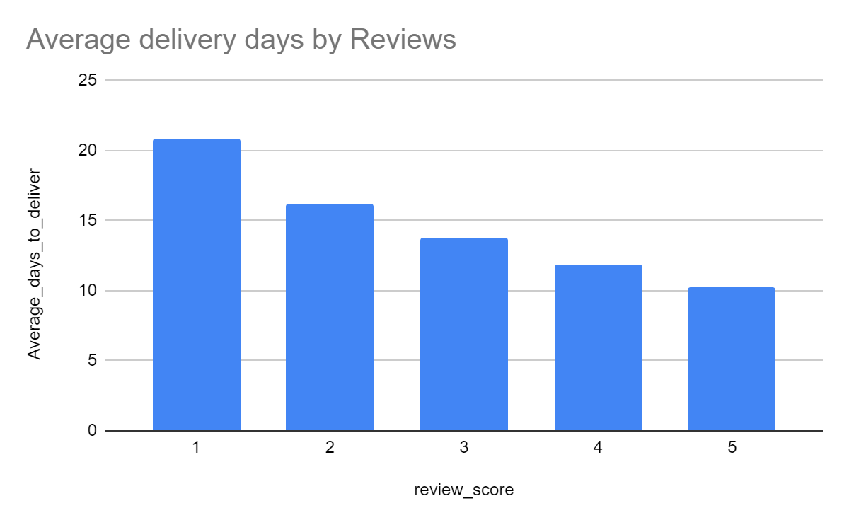
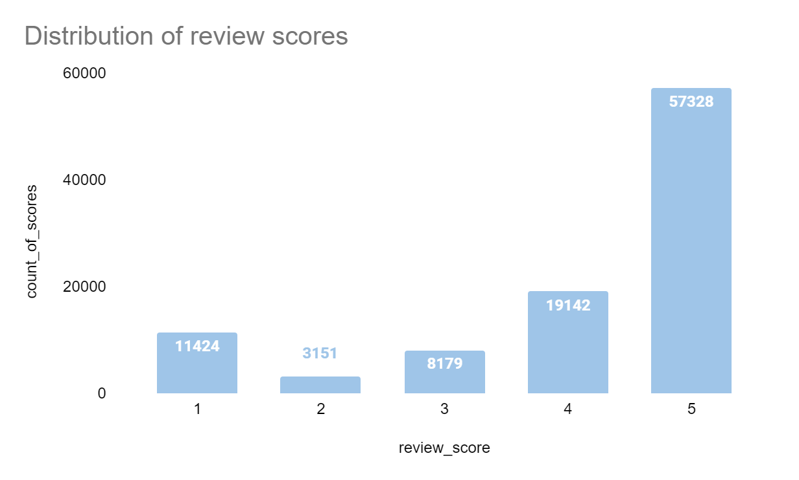
Product reviews
Overall product reviews are positive with the average score above 4. 84% are all positive reviews and 26% are all negative reviews.
Upon further analysis on the delivery times and review scores, when delivery times are more than 12 days, reviews are lower and more on the negative side.
Reducing delivery times below 2 weeks would affect customer satisfaction.

Slide 12
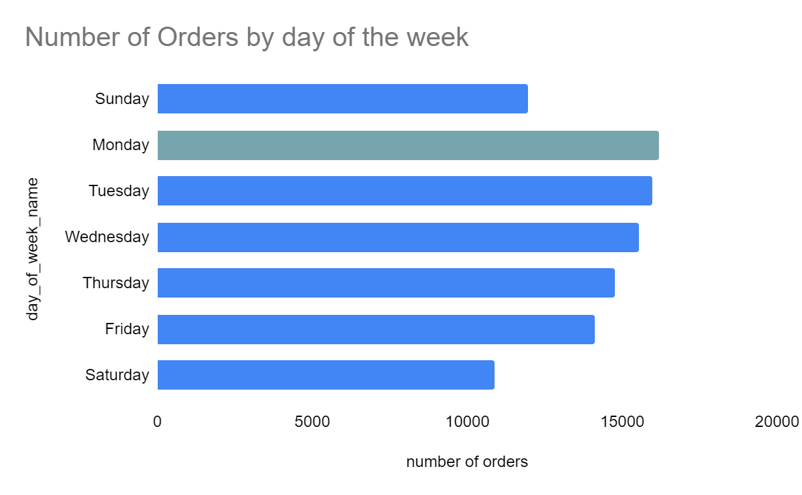
Customer Preferences Most customers prefer to shop on Mondays and overall, on weekdays rather than on weekends. This could help the Marketing team on which days they should deploy their campaigns to capture most of their customers for more activity on their online shops.

Slide 13
Limitations
This analysis done might not be enough to really see which factors contributes to customer success, there is need for more statistical analysis to predict customer satisfaction.
The 2016 data and the September 2018 to October 2018 was not presented well to analyse the revenue for those months.
In the dataset provided for review scores, there could be a further analysis on the review comments to see the actual words and to see if customers are really satisfied or not which was not provided in the dataset.

